Slide 1




DA 322M: Course Project
Fully Convolutional Networks for Semantic Segmentation
Vidya Sagar G Rasesh Srivastava

Slide 2
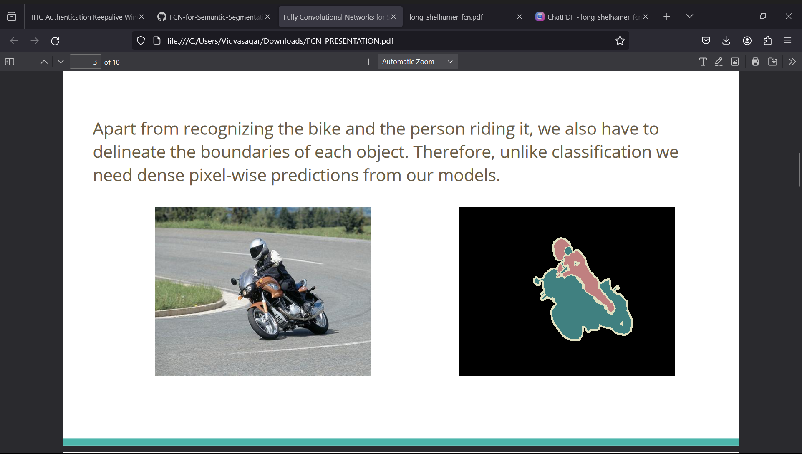
Introduction – Semantic Segmentation
1
Semantic segmentation plays a vital role in computer vision tasks by providing a detailed understanding of image content.
Semantic segmentation is understanding an image at the pixel level i.e. we want to assign each pixel in the image to an object class.
Fully Convolutional Networks (FCNs) have revolutionized the field of semantic segmentation by allowing end-to-end learning for pixelwise prediction tasks
Reinterpret standard classification convnets as “Fully convolutional” networks (FCN) for semantic segmentation and replaces the fully connected layers with convolutional layers.
2
Delineated boundaries of the object done at the pixel level – instance segmentation

Slide 3
Motivation – Why FCNs?
Efficient Dense Prediction:
Extend deep classification architectures by using image classification for pre-training
Fine-tune for efficient learning from whole images and ground truths
Spatial Understanding:
Leverage convolutional layers
Captures local and global context for accurate pixel-wise labeling
End-to-End Learning:
Direct learning from whole images and ground truths
Simplify training, reduce complex preprocessing and postprocessing
State-of-the-Art Performance:
Merge deep semantic info with fine details
Outperform traditional methods in accuracy and efficiency
Adaptability:
Extend to object detection and image classification
Maintain detailed predictions across tasks

Slide 4
Brief Literature
Jonathan Long, Evan Shelhamer, Trevor Darrell - "Fully Convolutional Networks for Semantic Segmentation" 2015 IEEE Conference on Computer Vision and Pattern Recognition (CVPR). (Link)
Olaf Ronneberger, Philipp Fischer, Thomas Brox – “U-Net: Convolutional Networks for Biomedical Image Segmentation” 2015 Medical Image Computing and Computer-Assisted Intervention(MICCAI) Conference (Link)
Liang-Chieh Chen, Yukun Zhu, George Papandreou, Florian Schroff, Hartwig Adam – “Encoder-Decoder with Atrous Separable Convolution for Semantic Image Segmentation” 2018 Computer Vision – ECCV (Link)

Slide 5
Objectives
To introduce FCNs as a novel approach to semantic segmentation and to develop a fully convolutional approach that operates directly on pixels and produces dense predictions.
To build “fully convolutional” networks that take input of arbitrary size and produce correspondingly-sized output in a single forward pass with efficient inference and learning.
To leverage pre-trained CNNs, such as VGG16 or AlexNet, for semantic segmentation tasks and to demonstrate how to convert these networks into fully convolutional ones and fine-tune them for pixel-wise predictions.
To demonstrate that FCNs can achieve state-of-the-art performance on semantic segmentation benchmarks, surpassing or matching the accuracy of previous methods while being computationally efficient.

Slide 6
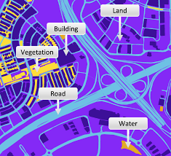
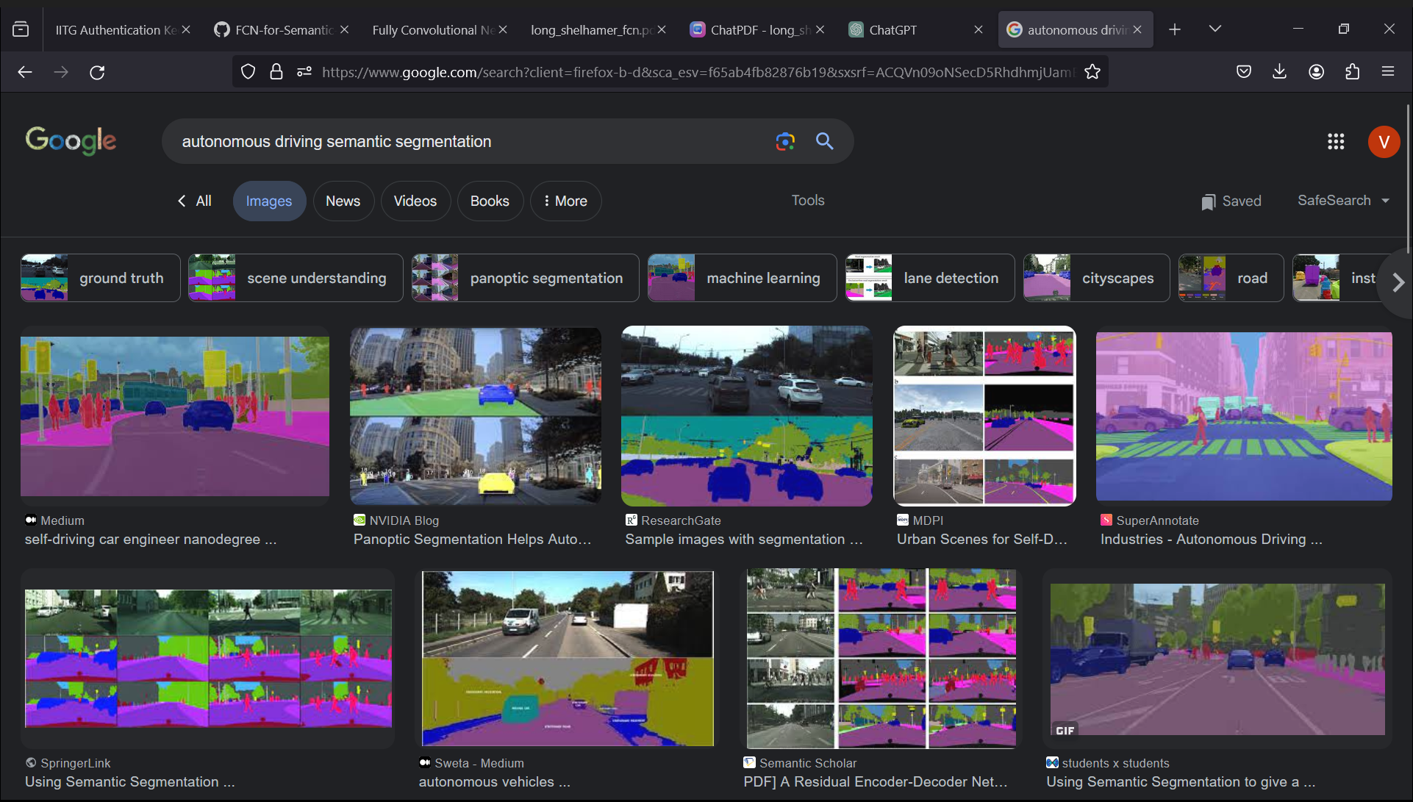
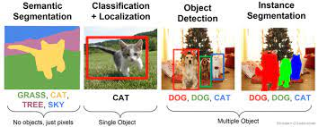
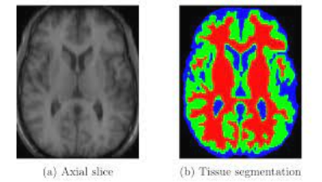
Applications/Use-Cases
Classification semantic segmentation & Instance segmentation
Satellite image segmentation
Autonomous Car Driving
Since FCNs adapt and extend deep classification models such as
AlexNet, VGGNet, GoogLeNet with the help of transfer learning and then fine-tuning to the segmentation task, they can extract precise details and perform better than the state of the art efficiently as well as accurately. Can be used for other tasks such as contour detection, optical flow and pixel labelling of microscopy images
Medical Image Analysis

Slide 7
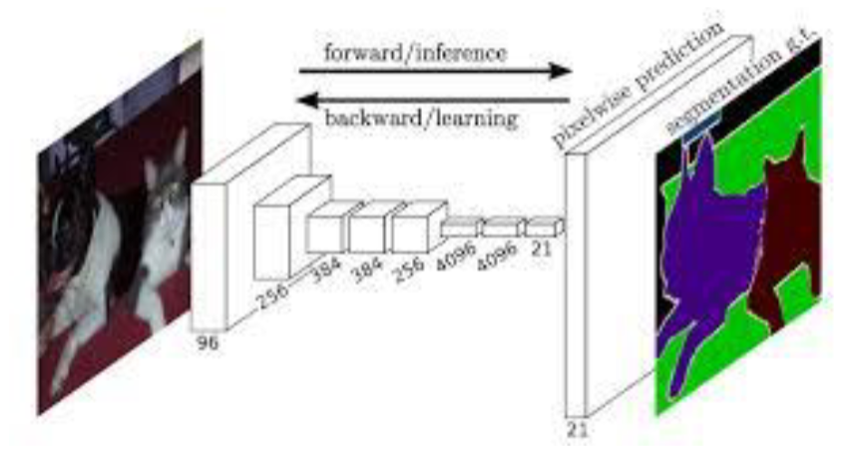
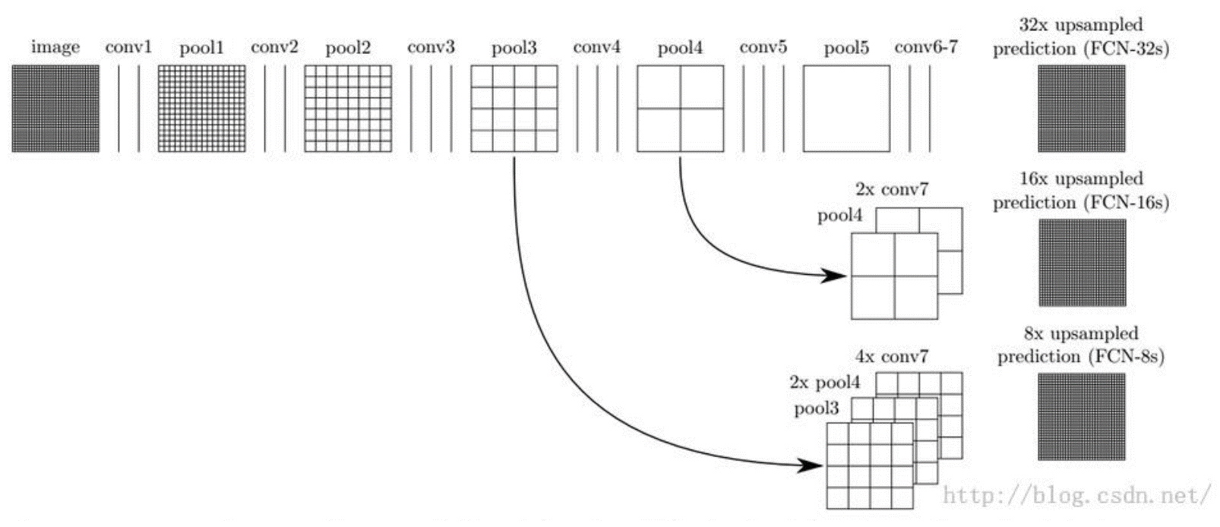
Methodology
3
4
Firstly ImageNet trained model like AlexNet is taken and the fully connected layers are replaced with convolution layers.
Then a series of deconvolution layers are used to up sample the image as we need to classify every pixel.
Skip layers which are indicated by arrows in the above image are used to transfer the information captured in the initial layers and was required for re construction during the upsampling
Due to absence of fully connected layers it can take input of any arbitrary size and produce the corresponding output

Slide 8
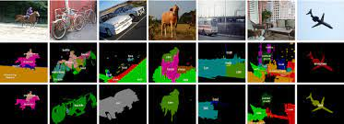
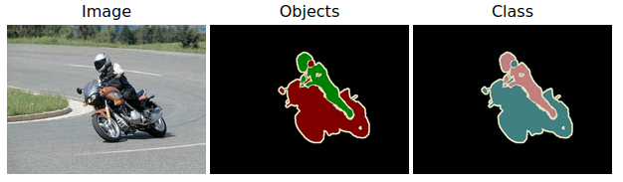
Data
5
6
Source of Dataset: PASCAL VOC 2011(PASCAL Visual Object Classes Challenge)
Metadata: pixel-level segmentation annotations, object class (21 classes) and bounding box annotations
Train/Val/Test Data split was as follows
Training Set: Around 1464 images with corresponding annotations
Validation and Testing Set: Around 1449 images with annotations,(hyperparameter tuning and model validation)
Data Preprocessing: (which did not yield noticeable improvement)
Randomly mirroring and “jittering” images by translating them up to 32 pixels
Sampling in patch-wise training to address reduction in number of possible batches and correct class imbalance

Slide 9
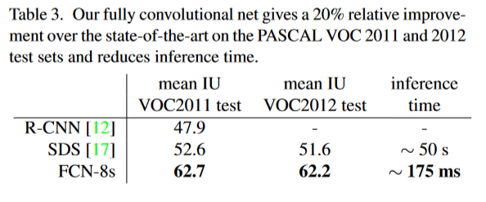
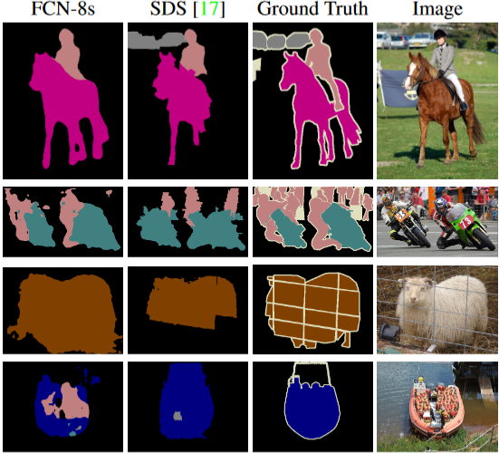
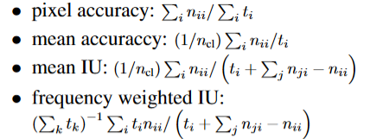
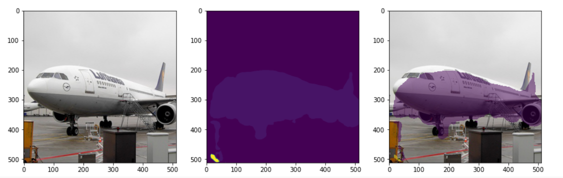
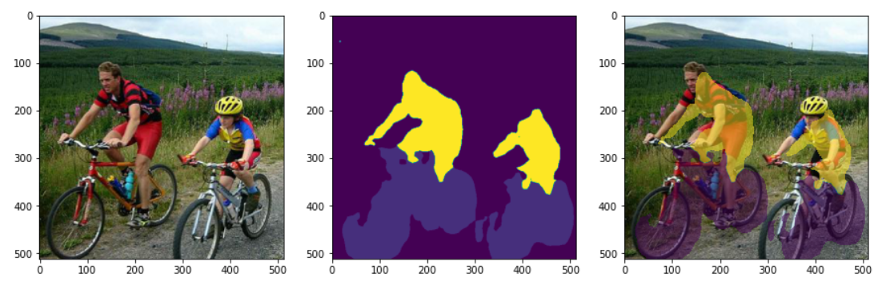
Results (Original and implemented)
FCN-8s performs better than state-of-the-art
Original paper results
Various metrics used
Implementation results – Actual, predicted and superimposed pictures

Slide 10
Summary
Fully convolutional networks (FCNs) are versatile models used for various tasks, not just image classification. They excel in segmenting images at the pixel level, known as semantic segmentation, instead of using bounding boxes. By combining multi-resolution layers, FCNs enhance their performance and speed up learning and inference.
Transfer learning is another technique that boosts efficiency by reusing pre-trained models, cutting down computational costs. FCNs have revolutionized tasks like contour detection, optical flow, weakly supervised semantic segmentation, and pixel labeling in microscopy images.
FCN popularized the use of end-to-end convolution networks for semantic segmentation. FCN is now used for contour detection, optical flow, weakly supervised semantic segmentation, and pixel labelling of microscopy images.

